Slide 1

Wind turbine Reliability analysis
UCSD DATA SCIENCE CERTIFICATE
2022 COHORT
7.28.22

Slide 2

Agenda
MEET THE TEAM
INDUSTRY INTRODUCTION
DATA: CLEANING AND STORAGE
SENSOR DATA ANALYSIS
MINOR FAULTS ANALYSIS
FINAL DATA PIPELINE?
LOOKING FORWARD

Slide 3





Meet the team
DAVE GRANT
Industry Insight
SARAH GALLAGHER
Data Transformation and Storage
ISAAC BRIESKE
Machine Learning and Front-end Visualization
ANDREW GOMOLL
Machine Learning
BRAYDEN DODSON
Data Transformation and Machine Learning

Slide 4
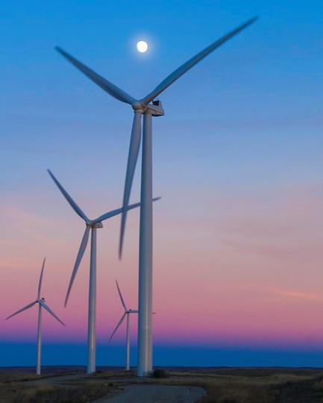
Industry Introduction
Insert a quality wind turbine picture here

Slide 5

DATA: Cleaning and Storage

Slide 6

Sensor data Analysis

Slide 7
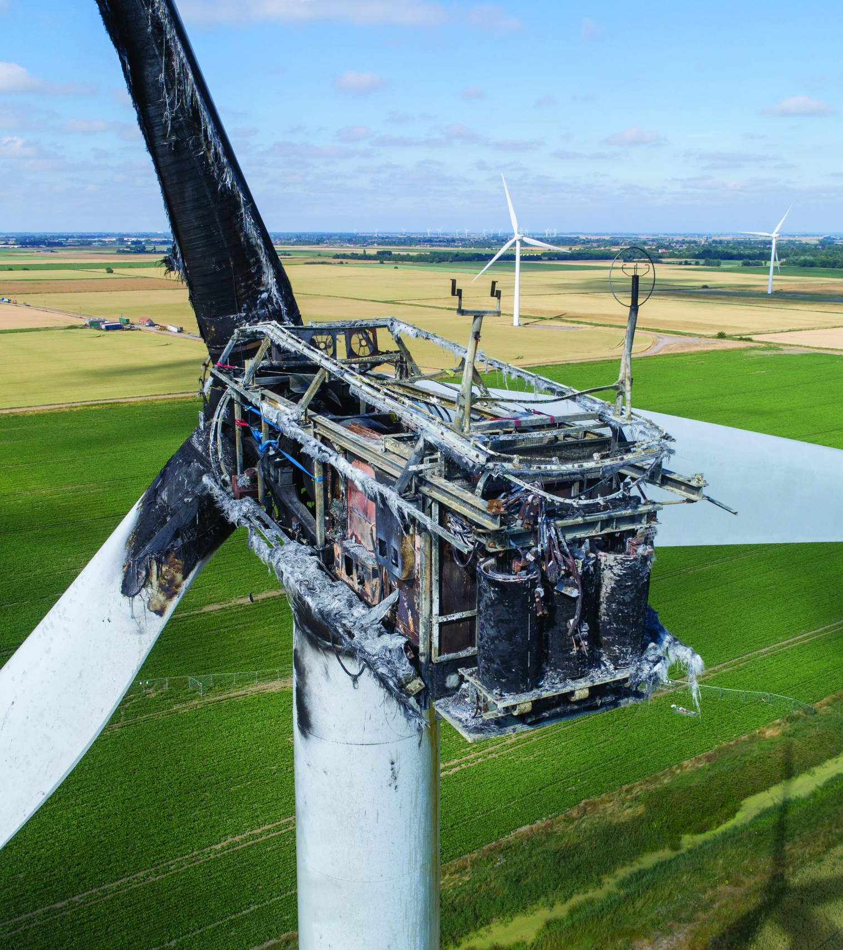
Minor Faults Analysis

Slide 8
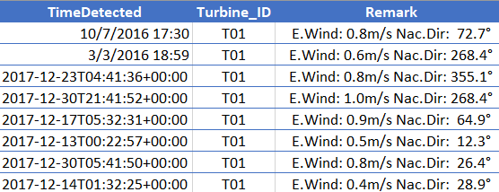
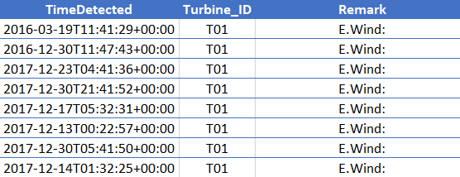
Data Transformation
DIRTY DATA
CLEANED AND TRANSFORMED DATA
Consists of all fault data for 4 turbines for 2 years
Inconsistent time formats that are not chronological
Individual “Remarks” for similar faults that should be grouped
Consistent datetime format and ordered chronologically
Condensed faults into like groups that are effectively the same
Transposed unique timeseries rows into dummies columns
Separated data for each turbine
Removed columns that contained no data

Slide 9
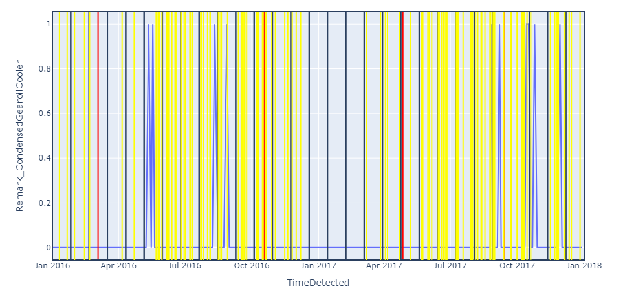
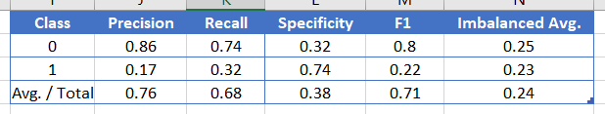
Machine Learning
POOR MODEL PERFORMANCE
POOR PREDICTIONS VISUALIZED
Model: Balanced Random Forest Model, Imbalanced Report
Precision: only 69% of predictions were correct
Recall: only 70% of the true positives were caught
Specificity: only 44% of the true negatives predicted correctly
F1: Low harmonic mean of 70%
Imbalanced Average: the data set was very imbalanced (27%)
Each yellow line is a prediction that there will be a major fault in the following bin
Each red line is a major fault
The model is overpredicting faults and doing so inconsistently
This model would increase spend on unnecessary service costs

Slide 10

LOOKING FORWARD

Slide 11
Confusion Matrix (Costs)
True positive: if issue is caught in advance, typical cost of repair is $
False Positive: Sending a repair man out unnecessarily costs $
False Negative:
If a turbine has a catastrophic failure, it takes x days and y dollars to repair it
Each day a turbine is down costs $ dollars
True Negative:
No costs
Yearly costs before model optimization:
Yearly costs after model optimization:
Model Benefit = 1. - 2. = $...

Slide 12

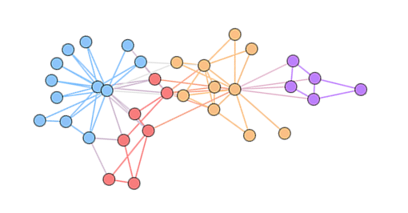
Future Analyses
TIMESERIES ML MODELS
The available data is in time series format which would benefit from a ML model that is designed for such
Binning inherently removes data of the first or final bin
Any specific models?
REALTIME DATA IMPORTING
The data used for this analysis is static and stored in a database
Future models would import data directly from the turbine sensors so that time-critical predictions can be made earlier

Slide 13
SUMMARY
SENSOR DATA APPROACH WORKED BEST
Isaac: please insert savings stats here based on confusion matrix and costs associated with each component (true pos, false pos, true neg, false neg)
CURRENT MODELS COULD BE FURTHER OPTIMIZED
If more industry data was sourced, it could benefit the models
OTHER ML MODELS SHOULD BE EXPLORED
Time series data should be analyzed by time series ML models

Slide 14
Supporting Links
GitHub: https://github.com/sarahrosegallagher/Wind_Turbine_Reliability_Analysis
Tableau Story:
Website:

Slide 15
Questions?

